Slide 1
Project Management
WBS, Estimation

Slide 2
WBS & Estimation
How did you feel when I asked
  “How long will your project take?”
Not an easy answer to give right?
At least not if I were are real customer on a real project
How can you manage that issue?

Slide 3
Partitioning Your Project
You need to decompose your project into manageable chunks
ALL projects need this step
Divide & Conquer
Two main causes of project failure
  Forgetting something critical
  Ballpark estimates become targets
Partitioning help this

Slide 4
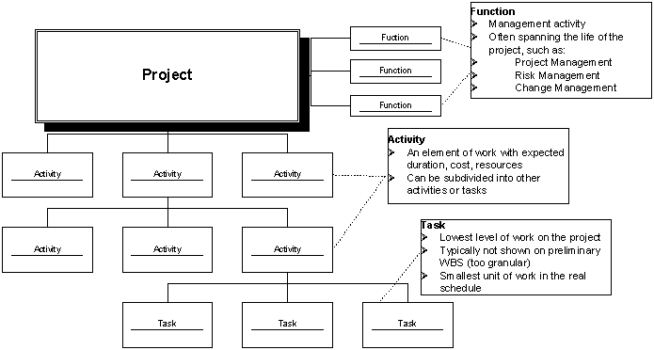
Project Elements
A Project: functions, activities, tasks

Slide 5
Work Breakdown Structure: WBS
Hierarchical list of project’s work activities
2 Formats
  Outline (indented format)
  Graphical Tree (Organizational Chart)
Uses a decimal numbering system
  Ex: 3.1.5
  0 is typically top level
Includes
  Development, Mgmt., and project support tasks
Shows “is contained in” relationships
Does not show dependencies or durations

Slide 6
WBS
Contract WBS (CWBS)
  First 2 or 3 levels
  High-level tracking
Project WBS (PWBS)
  Defined by PM and team members
  Tasks tied to deliverables
  Lowest level tracking

Slide 7
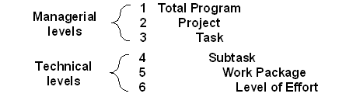
A Full WBS Structure
Up to six levels (3-6 usually) such as
Upper 3 can be used by customer for reporting (if part of RFP/RFQ)
Different level can be applied to different uses
  Ex: Level 1: authorizations; 2: budgets; 3: schedules

Slide 8
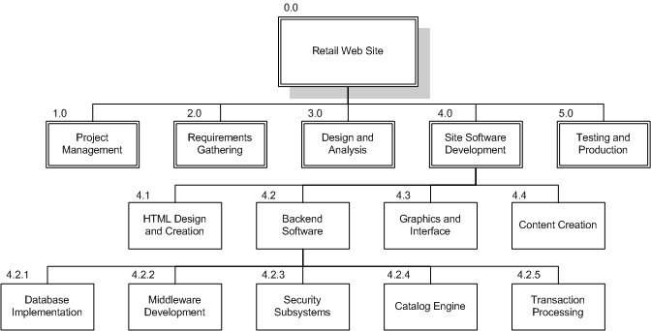
WBS Chart Example

Slide 9
WBS Outline Example
0.0 Retail Web Site
1.0 Project Management
2.0 Requirements Gathering
3.0 Analysis & Design
4.0 Site Software Development
4.1 HTML Design and Creation
4.2 Backend Software
4.2.1 Database Implementation
4.2.2 Middleware Development
4.2.3 Security Subsystems
4.2.4 Catalog Engine
4.2.5 Transaction Processing
4.3 Graphics and Interface
4.4 Content Creation
5.0 Testing and Production

Slide 10
WBS Types
Process WBS
    a.k.a Activity-oriented
    Ex: Requirements, Analysis, Design, Testing
    Typically used by PM
Product WBS
    a.k.a. Entity-oriented
    Ex: Financial engine, Interface system, DB
    Typically used by engineering manager
Hybrid WBS: both above
    This is not unusual
    Ex: Lifecycle phases at high level with component or feature-specifics within phases
    Rationale: processes produce products

Slide 11
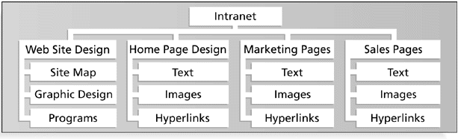
Product WBS

Slide 12
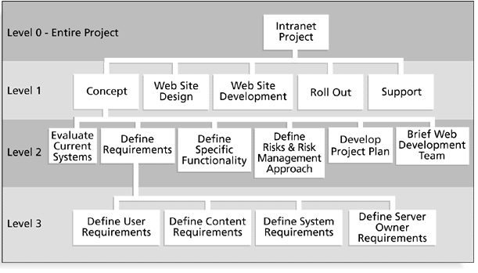
Process WBS

